Slide 1


Big Data Seminar – BIA 678
Big Data Analytics – Recommenders (Cont)
David Belanger PhD
Senior Research Fellow – Stevens Institute of Technology
dbelange@stevens.edu
http://www.examiner.com/images/blog/EXID1827/images/shamrock.jpg

Slide 2
Class 12 – Analytics I– Outline Occam’s Razor “Everything Should Be As Simple As Possible, But Not Simpler” – Albert Einstein
Administrative Stuff:
Team Project Questions
Activity #1 – Readings on big data Analytics
“A Brief Introduction to Boosting” Rob Schipire, http://rob.schapire.net/papers/Schapire99c.pdf
“XGBoost: A Scalable Tree Boosting System:”, Chen and Guestrin, https://arxiv.org/pdf/1603.02754.pdf,
Activity #2 – Lecture for Analytics II
Assignment :
“https://www.isaca.org/chapters3/Atlanta/AboutOurChapter/Documents/GW2014/Implementing%20a%20Data%20Governance%20Program%20-%20Chalker%202014.pdf
Thomas Wedell-Wedellsborg, Are You Solving the Right Problems, Harvard Business Review, Jan-Feb 2017 - On CANVAS
Source #1 - www.tableau.com/academic

Slide 3
Class 12+ Looking Ahead
Analytics:
“XGBoost: A Scalable Tree Boosting System:”, Chen and Guestrin, https://arxiv.org/pdf/1603.02754.pdf,
http://www.di.unipi.it/~cardillo/AA0304/fabio/boosting.pdf
A Decision theoretic generalization of on-line learning and application to boosting, Freund and Schapire https://cseweb.ucsd.edu/~yfreund/papers/adaboost.pdf
Thomas Wedell-Wedellsborg, Are You Solving the Right Problems, Harvard Business Review, Jan-Feb 2017
Reinforcement learning: An introduction, RS Sutton, AG Barto – 2018
Reinforcement Learning: A Tutorial Surveyand Recent Advances, Abhijit Gosavi
Visualization:
Shneiderman, Ben, Extreme Visualization: Squeezing a Billion Records into a Million Pixels http://www.cs.umd.edu/~ben/papers/Shneiderman2008Extreme.pdf
Nanocubes for Real-Time Exploration of Spatiotemporal Datasets Lauro Lins, James T. Klosowski, and Carlos Scheidegger; http://nanocubes.net/assets/pdf/nanocubes_paper.pdf , + http://www.nanocubes.net/ for demos and open source.
A possibly useful dataset:
http://grouplens.org/datasets/movielens/ - Do a SVD Recommender for the smaller dataset, using Python or Java or R.
Security, Privacy, etc.
Verizon Data Breach Digest 2017 (on CANVAS)
Article 29 Data Protection Working Party (Section 3 & Annex) (on CANVAS)

Slide 4
Formats for Team Project Talks
​No template - use the format that expresses your project the best, but in general there should be:
Introduction (including goals)
Data and Data Preparation
Analysis
Results
Performance Measurements
Conclusion
Talks should be about 5 minutes per individual (maybe 3 slides per person unless you are a practiced speaker).
Speak to the class, as opposed to only me, and look at them.

Slide 5
Formats for Team Project Reports
​No template - use the format that expresses your project the best, but in general there should be:
Introduction (including goals)
Data and Data Preparation
Analysis
Results
Performance Measurements
Conclusion
Report should be 5 - 10 pages (most will be closer to 10), double spaced with 12 point font. If there need to be displays of data or programs they should be in appendices (usually not necessary).

Slide 6
Impact of Scale: A Example of Classification Performance Results #3 Study by: Prashanth Ashok Ramkumar, Ram Kharawala, Qing Wei

Slide 7
Model-based approaches (Generally Item based due to scale)
Plethora of different techniques proposed in the last years, e.g.,
Matrix factorization techniques, statistics
singular value decomposition, principal component analysis
Association rule mining
compare: shopping basket analysis
Probabilistic models
clustering models, Bayesian networks, probabilistic Latent Semantic Analysis
Various other machine learning approaches
Costs of pre-processing

Slide 8
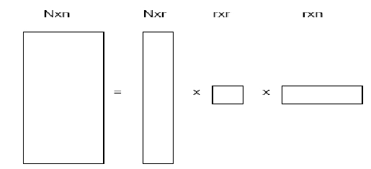
SVD
The eigenvalues and eigenvectors are defined for squared matrices.
For rectangular matrices, a closely related concept is Singular Value
Decomposition (SVD).
Theorem: Given an N x n real matrixA, we can express it as:
A= U xΛ x V^{T}
where U is a column-orthonormal N x r matrix, r is the rank of the
matrixA(number of linearly independent rows or columns),Λ is a
diagonal r x r matrix where the elements are sorted in descending
order, and V is a column-orthonormal n x r matrix.
SVD decomposition for a matrix is unique.
IyadBatal

Slide 9

SVD
The values of the diagonalΛ are called singular values. (we will see
later that they correspond to the square root of the eigenvalues of the
covariance matrix).
Theorem: the inverse of an orthonormal matrix is its transpose.
Proof: we know that
ThereforeA^{T}xA= I where I is the identity matrix.
From the definition ofA⁻¹ : A⁻¹ xA= I
→A⁻¹ =A^{T}
U^{T} x U = I and V^{T} x V = I
Also can be written using spectral decomposition as:
A= λ1U1 V1^{T} + λ2U2 V2 ^{T}+ … + λrUr Vr^{T}
IyadBatal

Slide 10
SVD
Theorem: if S is a real and symmetric (S=S^{T}) matrix then
S = U xΛ x UT. Where the columns of U are the eigenvectors, andΛ
is a diagonal matrix with values corresponding to eigenvalues.
Proof: let U be the matrix of eigenvectors placed in the columns:
U=[u1 u2 … un]
We can write: S x U=U xΛ
[S x u1 S x u2 … S x un]=[λ1.u1 λ2.u2 … λn.un] which is the definition
of the eigenvectors.
Therefore: S= U xΛ x U⁻¹
Because U is orthonormal → U⁻¹=U^{T}
→S = U xΛ x U^{T}
IyadBatal

Slide 11
The curse of dimensionality


Space is typically very sparse
Most dimensions are semantically useless

Hard for humans to tell which ones


Slide 12
Singular Value Decomposition
Computation takes O ( mn² ) with m >> n
Useful, but out of reach for very large datasets
Implemented in most statistical software systems
(often) better linear algebra approaches exist

Slide 13
A Single Value Decomposition Example
http://web.mit.edu/be.400/www/SVD/Singular_Value_Decomposition.htm

Slide 14
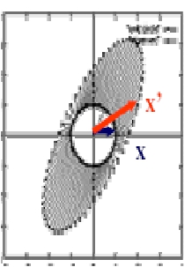
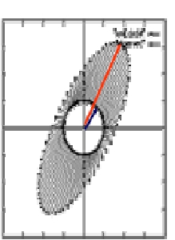
SVD
Geometrically, this means that if we multiple any vector with matrix
(A^{T}xA)k, then result is a vector that is parallel to the first
eigenvector.
IyadBatal

Slide 15

PCA and SVD
Summary for PCAand SVD
Objective: find the principal components P of a data matrix A(n,m).
1. First zero mean the columns ofA(translate the origin to the center of gravity).
2. Apply PCA or SVD to find the principle components (P) ofA.
PCA:
I.
Calculate the covariance matrix C=
II. p = the eigenvectors of C.
III. The variances in each new dimension is given by the eigenvalues.
SVD:
I.
Calculate the SVD ofA.
II. P = V: the right singular vectors.
III. The variances are given by the squaring the singular values.
3. Project the data onto the feature space. F = P xA
4. Optional: Reconstruct A from Y where A’is the compressed version ofA.
IyadBatal

Slide 16
2000: Application of Dimensionality Reduction in Recommender System, B. Sarwar et al., WebKDD Workshop
Basic idea: Trade more complex offline model building for faster online prediction generation
Singular Value Decomposition for dimensionality reduction of rating matrices
Captures important factors/aspects and their weights in the data
factors can be genre, actors but also non-understandable ones
Assumption that k dimensions capture the signals and filter out noise (K = 20 to 100)
Constant time to make recommendations
Approach also popular in IR (Latent Semantic Indexing), data compression,…

Slide 17
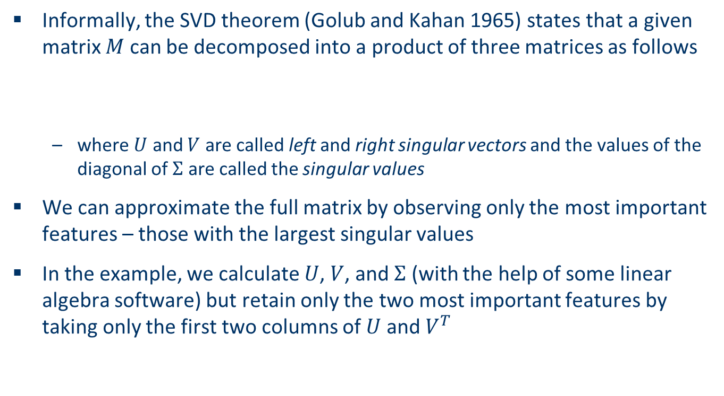
Matrix factorization

Slide 18
Singular Value Decomposition (SVD)
SVD is a factorization of a matrix: M = U Σ V^{T}
M is the “ratings” matrix
Σ is a diagonal matrix of singular values (think of them as weighting factors for U and V.
U and V are the eigenvectors of M M ^{T} and M ^{T} M respectively.
The singular values are the square roots of the eigenvalues of M M ^{T} corresponding to the eigenvectors in U and V.

Slide 19
Singular Value Decomposition (SVD)
M
U
Σ
V^{T}
=

Slide 20
Singular Value Decomposition (SVD) Finding U and V (a small example)
2 | 4
1 | 3
0 | 0
0 | 0
Find the SVD for matrix M=
That is: Find the eigenvalues and eigenvectors of M M ^{T} and M ^{T} M
Eigenvectors of M ^{T} M are the columns of V
Eigenvectors of M M ^{T} are the columns of U
The singular values of Σ are the eigenvalues of U and V.
So:
anhttp://web.mit.edu/be.400/www/SVD/Singular_Value_Decomposition.htm

Slide 21
Singular Value Decomposition (SVD) and Principal Component Analysis (PCA)
Recall PCA creates coordinates with greatest influence on the analysis.
It does this by calculating the eigenvalues and eigenvectors of the covariance (or correlation) matrix.
One can calculate SVD using PCA in a variety of ways, for example:
Translate each data column to have mean=0
Then diagonalizing X ^{T} X provides the principal components.
At least as likely to calculate PCA using SVD at scale. For example:
Subtract the column means from the data matrix.
Take SVD
The Columns of V _{K} are principal components.
Values of the w _{I} , i.e. diagonal elements of Σ give “importance” of each element.

Slide 22
Singular Value Decomposition (SVD) Finding U and V (and example)
2 | 4
1 | 3
0 | 0
0 | 0
Find the SVD for matrix M=
20 | 14 | 0 | 0
14 | 10 | 0 | 0
0 | 0 | 0 | 0
0 | 0 | 0 | 0
M M ^{T} =
Eigenvalues are: λ = 0, 0, 29.88, 0.117
Equation systems for Eigenvectors:
19.88X1 + 14X2 = 0 and -.988X1 +14X2 = 0
14X1 + 9.88X2 = 0 14X1 – 19.88X2 = 0
X3 = 0 X3 = 0
X4 = 0 X4 = 0
Therefore:

Slide 23
Singular Value Decomposition (SVD) Finding U and V (and example)
2 | 4
1 | 3
0 | 0
0 | 0
Find the SVD for matrix M=
Eigenvalues are: λ = 0, 0, 29.88, 0.117
Equation systems for Eigenvectors:
19.88X1 + 14X2 = 0 and -.988X1 +14X2 = 0
14X1 + 9.88X2 = 0 14X1 – 19.88X2 = 0
X3 = 0 X3 = 0
X4 = 0 X4 = 0
Therefore:
U =
.82 | -.58 | 0 | 0
.58 | .82 | 0 | 0
0 | 0 | 1 | 0
0 | 0 | 0 | 1

Slide 24
Singular Value Decomposition (SVD) Finding U and V (and example)
2 | 4
1 | 3
0 | 0
0 | 0
Find the SVD for matrix M=
Similarly, using M ^{T} M, we get:
V =
And since Σ is obtained from the eigenvalues λ, we get:
Σ =
.40 | -.91
.91 | .40
5.47 | 0
0 | 0.37

Slide 25
Singular Value Decomposition (SVD) Finding U and V (and example)
2 | 4
1 | 3
0 | 0
0 | 0
Find the SVD for matrix M=
Eigenvalues are: λ = 0, 0, 29.88, 0.117
Equation systems for Eigenvectors:
19.88X1 + 14X2 = 0 and -.988X1 +14X2 = 0
14X1 + 9.88X2 = 0 14X1 – 19.88X2 = 0
X3 = 0 X3 = 0
X4 = 0 X4 = 0
Therefore:
U =
.82 | -.58 | 0 | 0
.58 | .82 | 0 | 0
0 | 0 | 1 | 0
0 | 0 | 0 | 1

Slide 26
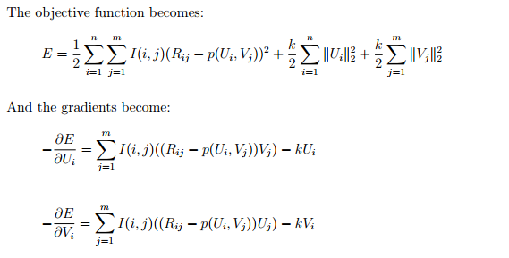
Regularized Singular Value Decomposition (SVD)
Regularization:
Controls the weight of feature vectors, and
Limits updates from increasing weight on any individual feature vector too much
Controls over-fitting and allows more features
https://classes.soe.ucsc.edu/cmps242/Fall09/proj/mpercy_svd_paper.pdf

Slide 27
Steps in a Regularized Singular Value Decomposition (SVD) for Recommendation (in part due to the Netflix Competition, there are an amazing number of subtly different methods)
Fill in the empty spots in the original matrix – with 0’s, means, or some other estimator.
Some recommend approaches like subtracting the movie mean from the individual movie values as a way of improving the results.
Carry out SVD reconstruction of rank k (k determined using the singular value table) to recover improved values for ratings. Lower k’s will reduce over-fitting.
Calculate for all missing values.

Slide 28
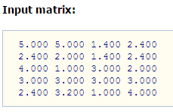
SVD Recommender Example - 1 X = User/Item
Matrix Algebra using: http://www.bluebit.gr/matrix-calculator/multiply.aspx

Slide 29
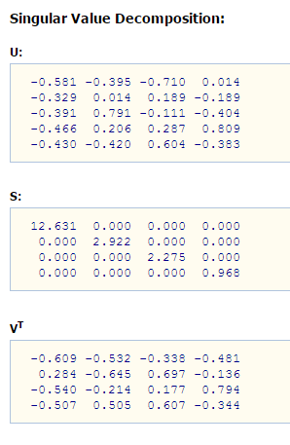
SVD Recommender Example - 2 SVD of X

Slide 30
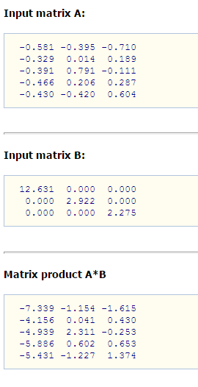
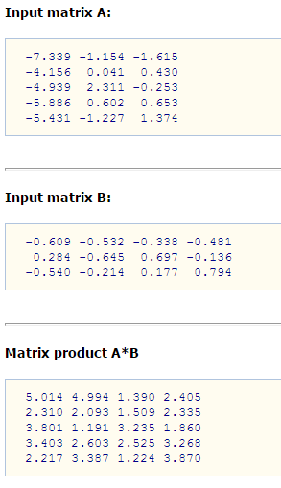
SVD Recommender Example - 3
U
S
UxS
UxS
V^{T}
UxSxV^{T}

Slide 31
Example for SVD-based recommendation
K-Rank = 2
SVD:
Terminator
Die Hard
Twins
Eat Pray Love
Pretty Woman
U_{k} | Dim1 | Dim2
Alice | 0.47 | -0.30
Bob | -0.44 | 0.23
Mary | 0.70 | -0.06
Sue | 0.31 | 0.93
V_{k}^{T}
Dim1 | -0.44 | -0.57 | 0.06 | 0.38 | 0.57
Dim2 | 0.58 | -0.66 | 0.26 | 0.18 | -0.36
 | Dim1 | Dim2
Dim1 | 5.63 | 0
Dim2 | 0 | 3.23
Prediction:
= 3 + 0.84 = 3.84

Slide 32
SVD Spreadsheet
Excel SVD Calculations

Slide 33
Recommender Systems – Matrix Factorization Alternating Least Squares
Given a User – Item, A, Matrix with m users and n items, ALS will factor A into 2 matrices, U (mxk) and V (kxn) whose product approximates A, and minimizes the cost function:
J = || A – UxV ^{T} || ₂ + λ (||U|| ₂ + ||V|| ₂ )
First term is MSE between original matrix and its approximation.
Second term is “regularization term” which generalizes the solution to prevent overfitting.

Slide 34
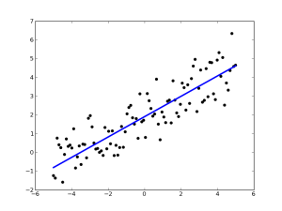
Recommender Systems – Matrix Factorization Alternating Least Squares
Given a User – Item, A, Matrix with m users and n items, ALS will factor A into 2 matrices, U (mxk) and V (kxn) whose product approximates A, and minimizes the cost function:
J = || A – UxV ^{T} || ₂ + λ (||U|| ₂ + ||V|| ₂ )
Considering the first term, if we fix V, this becomes a problem of multiple linear regression, and similarly if we fix U it is a problem of multiple linear regression.
So, we can solve for local minima but iteratively fixing first V, then U, and applying least squares regression to get an approximation. Then alternating and iterating.

Slide 35
Recommender Systems MF(e.g. ALS) vs. SVD
How do these compare:
SVD has stronger guarantees than MF
The middle matrix, Σ, in UxΣxV ^{T} is a diagonal matrix of singular values
U and V are column orthonormal matrices
SVD solution is unique
Can estimate total variance by sum of singular values
SVD Challenges:
Computationally Complex
Original matrix must be fully dense

Slide 36
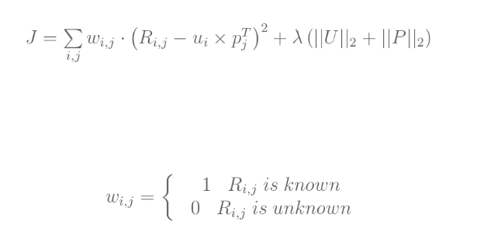
Recommender Systems MF(e.g. ALS) vs. SVD
How do these compare:
In the case of MF, missing values are allowed giving:

Slide 37
Association rule mining
A classical technique for discovering rules from transactional data.
Most commonly stated rule is {diapers} => {beer}, a result which has been know for almost 50 years.
Advantage: Conceptually very simple.
Disadvantage: Implementation at scale a challenge.

Slide 38
Association rule mining
Problem Statement: Given a set of transactions, find rules that will predict the occurrence of an item based on the occurences of other items.
For example:
Transaction Items
Bread, Milk
Bread, Diaper, Beer, Eggs
Milk, Diaper, Beer, Cola
Bread, Milk, Diaper, Beer
Bread, Milk, Diaper, Cola
Rules
{Diapers} -> Beer
{Milk, Bread} -> {Eggs, Cola}
{Beer, Bread} -> {Milk}

Slide 39
Association rule mining
Some Definitions:
Item set: A collection of one or more items
Support Count: Frequency of occurrence of an item set. Denoted σ (item set)
Support: Fraction of transactions that contain an item set. Denoted s (item set)
Minsup: lower threshold for frequent item set.
Confidence: Number of times an item set Y appears in transactions that contain X. Denoted c(item set).

Slide 40
Association rule mining
Formal Definition:
Given a set of transactions T, find
Support ≥ minsup threshold
Confidence ≥ minconf threshold
Approaches:
Rules originating from the same item set have identical support
Rules originating from the same item set may have different confidence
Therefore support and confidence requirements can be decoupled.

Slide 41
Association rule mining
Formal Definition:
Given a set of transactions T, find
Support ≥ minsup threshold
Confidence ≥ minconf threshold
Approaches (continued):
Generate all item sets where support ≥ minsup, these are called frequent item sets.
Generate high confidence rules from each of the above.
Each rule is a binary partitioning of a frequent item set.
Complexity is exponential in the number of items

Slide 42
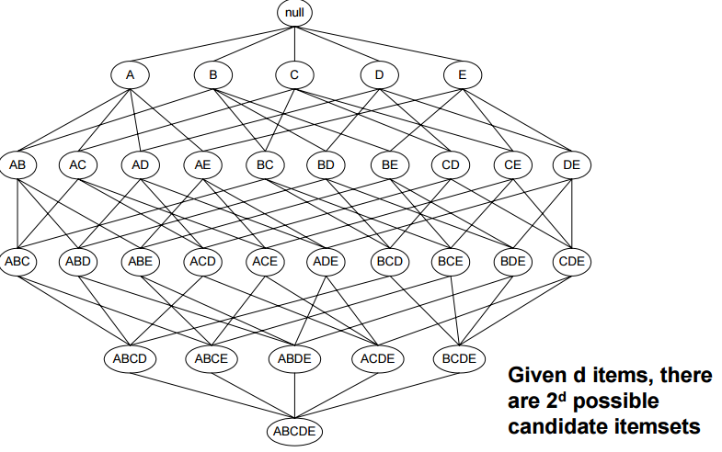
Frequent Item Set Generation (Note this reduces to a graph problem)

Slide 43

Association rule mining
Approaches (continued):
Use pruning to reduce the number of candidates
Reduce the number of transactions
Use efficient data structures to reduce the number of comparisons
Apriori Principle:
If an Item Set is Frequent, then all of its subsets must also be frequent
Support for an item ≤ support for its subsets

Slide 44
Association rule mining
Formal Definition:
Given a set of transactions T, find
Support ≥ minsup threshold
Confidence ≥ minconf threshold
Approaches (continued):
Generate all item sets where support ≥ minsup, these are called frequent item sets.
Generate high confidence rules from each of the above.
Each rule is a binary partitioning of a frequent item set.
Complexity is exponential in the number of items

Slide 45
Apriori Method
Let K = 1
Generate Frequent Item Sets of length 1
Repeat until no new frequent item sets are identified
Generate length K+1 candidate item sets from length K frequent item sets
Prune candidate item sets containing subsets of length K that are not frequent
Count the support of each candidate – DB Scan
Eliminate candidates that are not frequent
Likely to use a hash tree for implementation

Slide 46
Apriori Method (Factors to Reduce Complexity)
Raise minimum support level -> fewer item sets
Reduce dimension, i.e. number of items, reduces space and computational requirements
Reduce number of transactions reduced size of DB scans
Reduce transaction width
Use matrix format for complex representation

Slide 47
Apriori Method Rule Generation
Given a frequent item set L, find all non-empty subsets f of L such that f -> L – f satisfies the minimum confidence requirement.
If |L| = K, then there are 2 ^{K} -2 candidate association rules.
Can this be done efficiently?
Confidence is not anti-monotone. I.e. c(ABC -> D) can be larger or smaller than c(AB -> D)
But confidence of rules generated from the same item set is anti-monotone.
I.e. c(ABC -> D) ≥ c(AB -> CD) ≥ c(A -> BCD)
Support distribution can be skewed (e.g. expensive items have lower volume), hence different items may have different minsup values.

Slide 48
Recommendation based on Association Rule Mining
 | Item1 | Item2 | Item3 | Item4 | Item5
Target | 1 | 0 | 0 | 0 | ?
User1 | 1 | 0 | 1 | 0 | 1
User2 | 1 | 0 | 1 | 0 | 1
User3 | 0 | 0 | 0 | 1 | 1
User4 | 0 | 1 | 1 | 0 | 0
Simplest approach
transform 5-point ratings into binary ratings (1 = above user average)
Mine rules such as
Item1 → Item5
support (2/4), confidence (2/2) (without Target)
Make recommendations for Target(basic method)
Determine "relevant" rules based on Target’stransactions (the above rule will be relevant as Target bought Item1)
Determine items not already bought by Target
Sort the items based on the rules' confidence values
Different variations possible
dislike statements, user associations ..

Slide 49
Discussion about dimensionality reduction (Sarwar et al. 2000a)
Matrix factorization
Generate low-rank approximation of matrix
Detection of latent factors
Projecting items and users in the same n-dimensional space
Prediction quality can decrease because…
the original ratings are not taken into account
Prediction quality can increase as a consequence of…
filtering out some "noise" in the data and
detecting nontrivial correlations in the data
Depends on the right choice of the amount of data reduction
number of singular values in the SVD approach
Parameters can be determined and fine-tuned only based on experiments in a certain domain
Koren et al. 2009 talk about 20 to 100 factors that are derived from the rating patterns

Slide 50
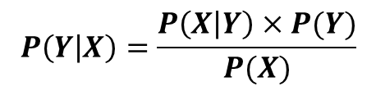
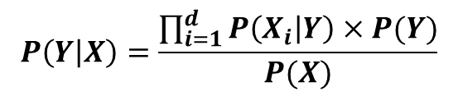
Probabilistic methods
Basic Idea similar to Naïve Bayesian Classification:
Given the User/Item rating matrix find the probability that a target will “like” a given item.
Create a recommendation from these probabilities
Calculate the conditional probability that the target will “like” an item given the Target’s previous ratings.
That is: P(Item(i)=p|X)
Bayes Theorem with “Naïve” assumption:

Slide 51
Bayesian Recommendation
 | Item1 | Item2 | Item3 | Item4 | Item5
Target | 1 | 3 | 3 | 2 | ?
User1 | 2 | 4 | 2 | 2 | 4
User2 | 1 | 3 | 3 | 5 | 1
User3 | 4 | 5 | 2 | 3 | 3
User4 | 1 | 1 | 5 | 2 | 1
P((1,5)=1|Target) = P((1,1)=1|Column5=1)* P((1,2)=3|Column5=1)* P((1,3)=3|Column5=1)* P((1,4)=2|Column5=1)/Constant
ETC.
P((1,5)=1|Target) = (2/2)(1/2)(1/2)(1/2) = 1/8
ETC.

Slide 52


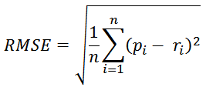
2008: Factorization meets the neighborhood: a multifaceted collaborative filtering model, Y. Koren, ACM SIGKDD
Stimulated by work on Netflix competition
Prize of $1,000,000 for accuracy improvement of 10% RMSE compared to own Cinematch system
Very large dataset (~100M ratings, ~480K users , ~18K movies)
Last ratings/user withheld (set K)
Root mean squared error metric optimized to 0.8567
Metrics measure error rate
Mean Absolute Error (MAE) computes the deviation between predicted ratings and actual ratings
Root Mean Square Error (RMSE) is similar to MAE, but places more emphasis on larger deviation

Slide 53
2008: Factorization meets the neighborhood: a multifaceted collaborative filtering model, Y. Koren, ACM SIGKDD
Merges neighborhood models with latent factor models
Latent factor models
good to capture weak signals in the overall data
Neighborhood models
good at detecting strong relationships between close items
Combination in one prediction single function
Local search method such as stochastic gradient descent to determine parameters
Add penalty for high values to avoid over-fitting

